Slide 1
CHOCOLATE CAKE
Ingredients and recipes

Slide 2
INGREDIENTS
2: Eggs
1 tbsp: Baking powder
1/2 cup: sugar
3/4 cup: Cocoa powder
1 cup: flour
1 (6 g) tsp: Salt
3/4 cup: oil
1 tbsp: vanilla
1 cup: Milk

Slide 3
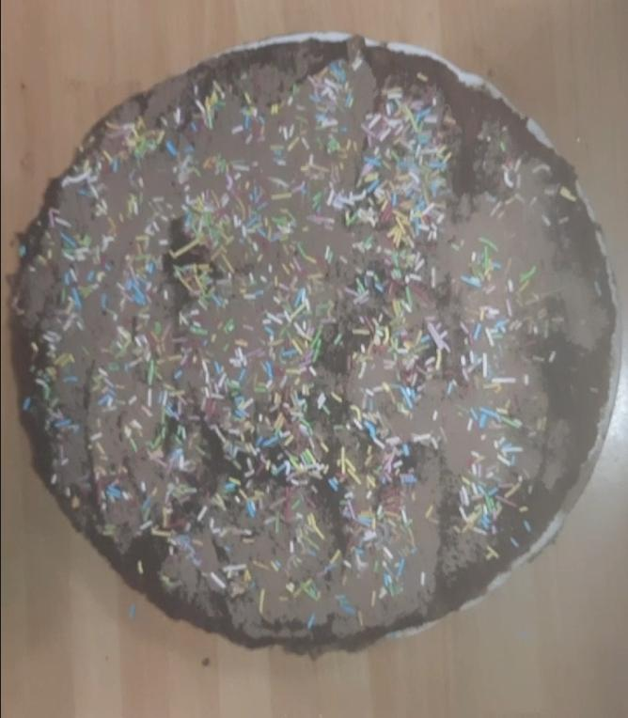
RECIPE
First, break 2 eggs and stir them in a bowl with 1 cup of milk,½ cup of sugar, pinch of salt, ¾ cup of cocoa powder, ¾ cup of oil, 1 pinch of baking powder, 1 pinch of vanilla and finally 1 cup of flour. Then put the mixture in the cake mold and throw it in the oven at a temperature of 180 for 40 minutes.
And finally the resolution

